Slide 1
Social Collab Site

Slide 2
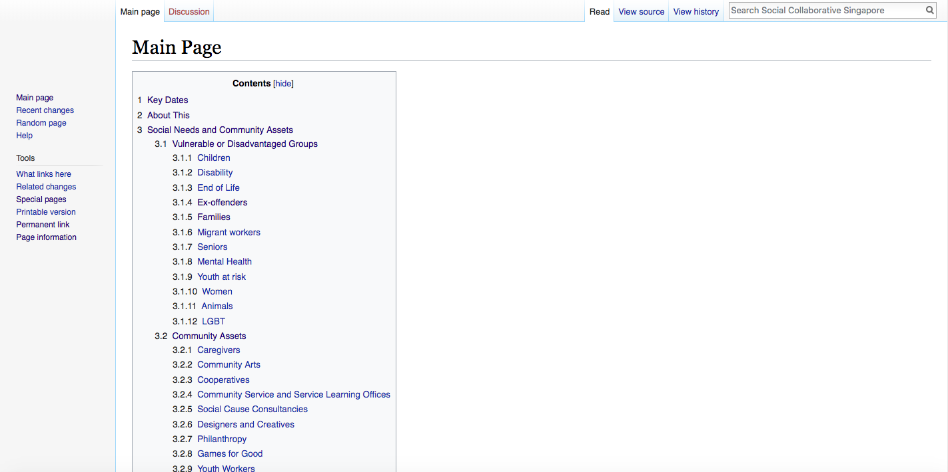
Community sharing
Notes:
It was created with sharing in mind.
To allow people with different knowledge to share their input via a platform.

Slide 3
Transition
Closed Beta
Public release
Notes:
Soon, we will be moving towards the next phase.
We intend to open to public to reach out to more people. However, before we do that…
There are a few things we need to work on.

Slide 4
Moving on..
Feel & Look of the site
Improving User interface and experience
Stability of site
Security
Encryption on sensitive page - e.g login
Purchase of security certification
Manpower for managing site
Content moderator
Support/enhancement for website
Notes:
User interface: Currently the site looks dull with wall of texts. We are working to improve on the overall feel of the site, especially on the navigation. For those that are currently using the site, feel free to give your input
Stability: Reduce the occurrence of “not responding” or slow respond.
Security: Prevent people from sniffing sensitive content e.g (login credential etc.)
Manpower: Need more people to manage website & provide customer service (to prepare to open to public).
Content moderator: remove inappropriate content – to prepare for public release.

Slide 5
Cost of using platform
Item | Cost (SGD)
Hosting server * | 20 – 26 /month
SSL certificate ** | 80 – 420 /year
*Cost is not fix and is sorely depend on the usage per month
** Price is based on the type of certificate you choose
Notes:
Hosting server: Pricing is based on instances usage (duration) and the size of the server. Currently the hosting is using ”small”, recently upgraded from ”micro”.
SSL (Secure socket layer): Standard security technology to establish encrypted link between a web server and a browser.

